Slide 1



Employee MyBenefits Portal Tutorial
Employee MyBenefits Portal Tutorial
Login Process

Slide 2
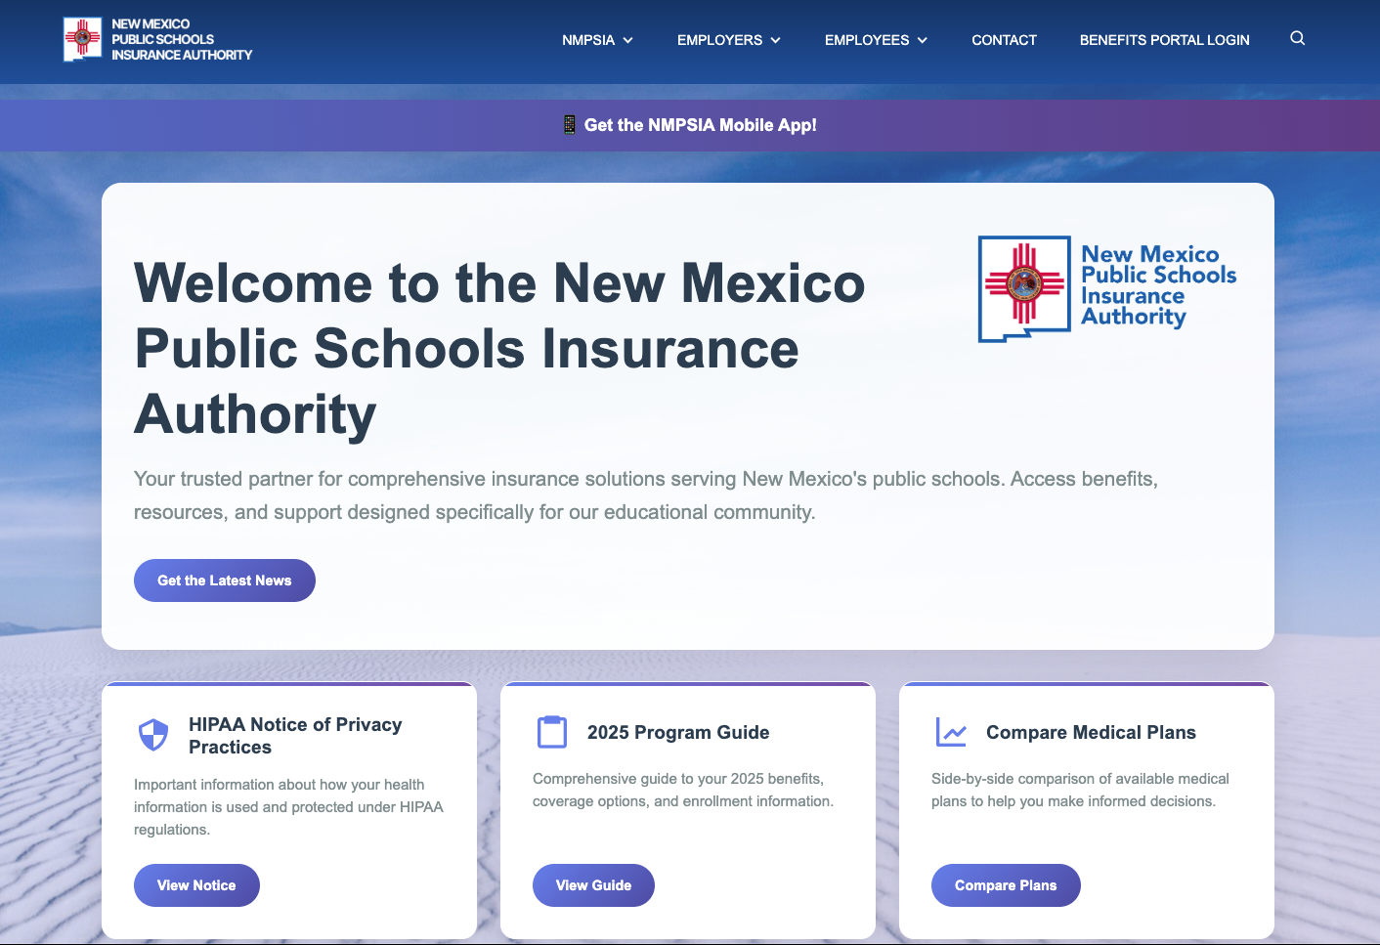
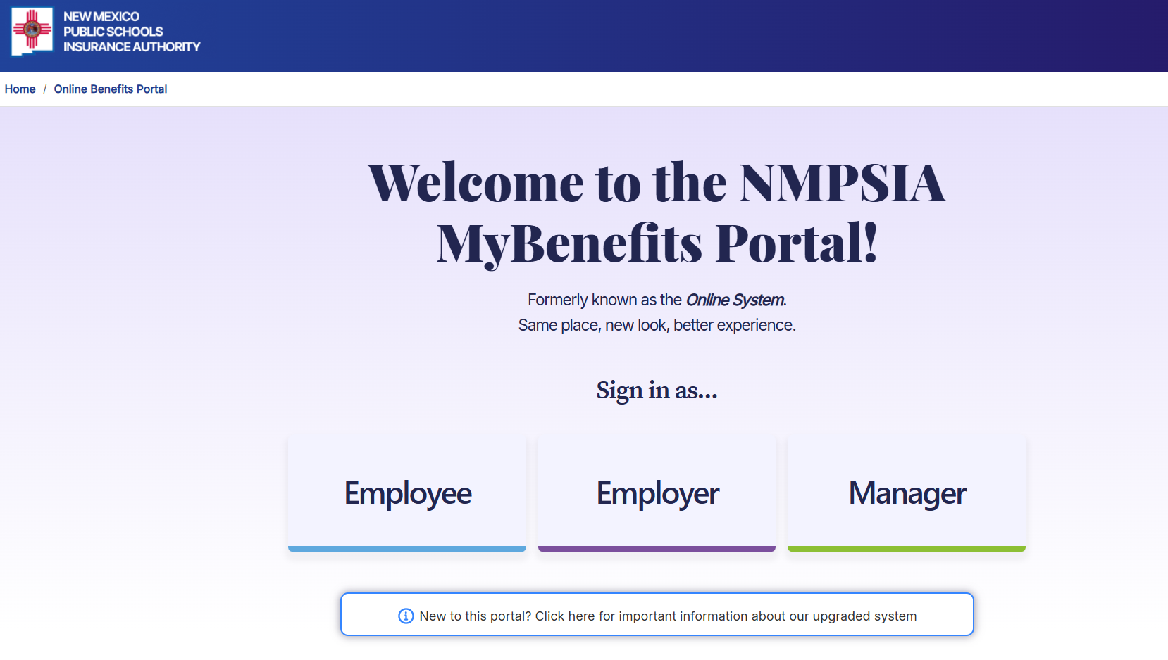
Step 1 NEW USER
Slide 2 of 21
NEW USER
Go to NMPSIA.com
↓
Benefits Portal Login
↓
Select Employee
↓
Continue to Step 2

Slide 3
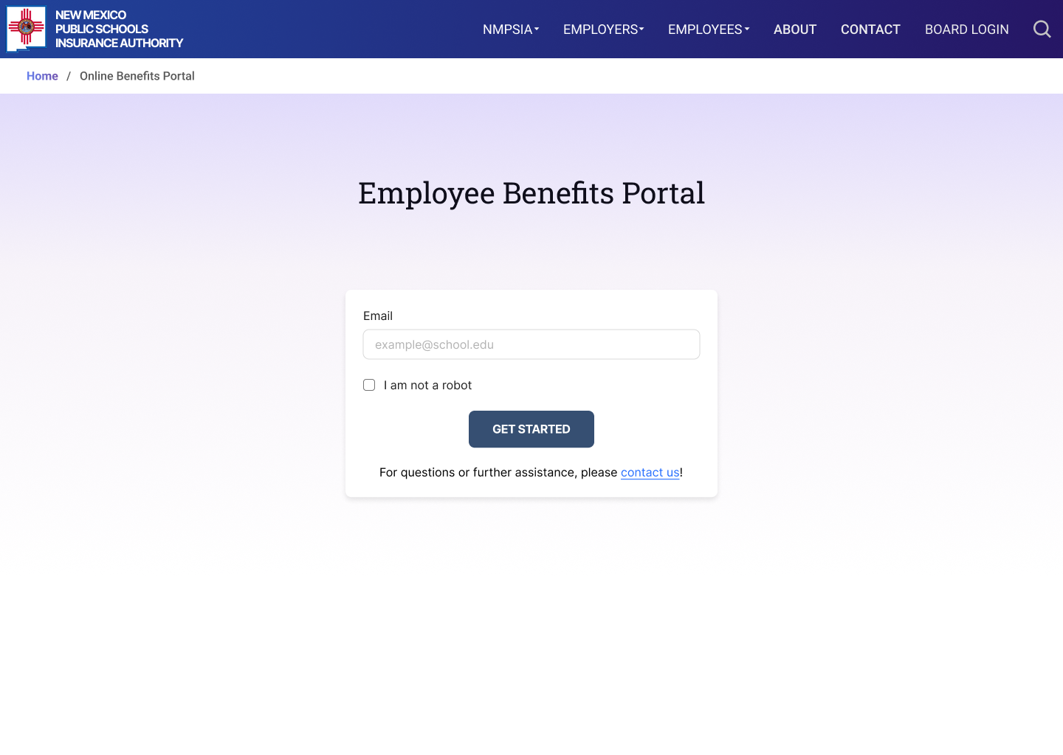
Step 2 NEW USER
Slide 3 of 21
NEW USER
1. Enter the email you provided when you enrolled in NMPSIA benefits.
2. Certify you are not a robot.
3. Click GET STARTED.
1
2
3

Slide 4
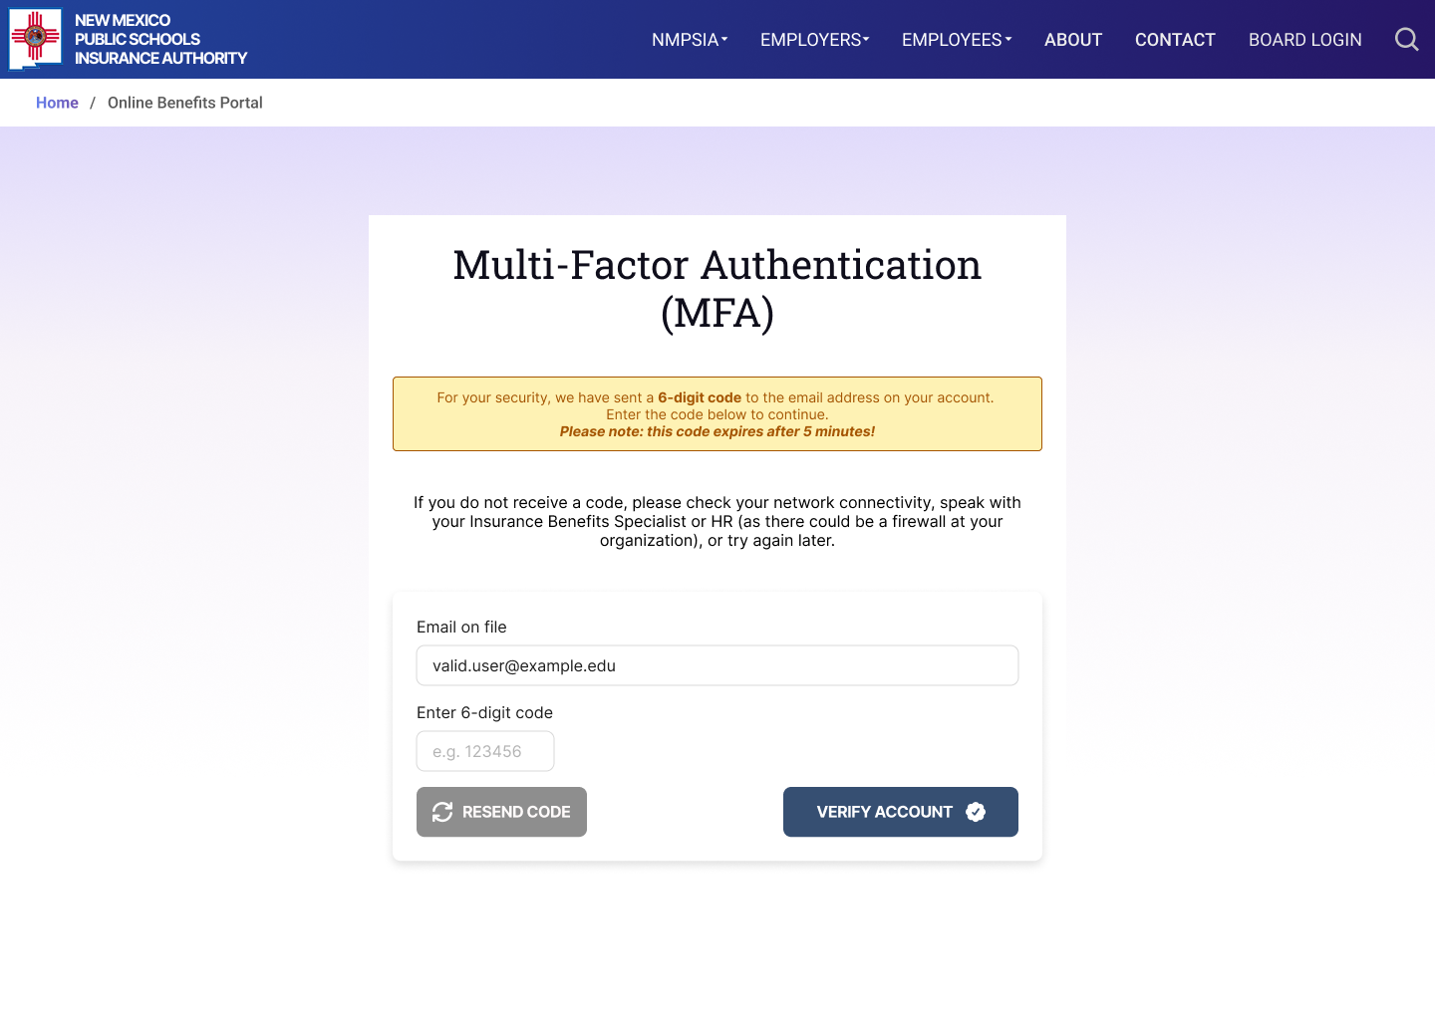
Step 3 NEW USER
Slide 4 of 21
NEW USER
A Multi- Factor Authentication (MFA) code will be sent to your email.
1. Enter the code and
2. Click VERIFY ACCOUNT
Note: This code will expire after 5 minutes.
1
2

Slide 5
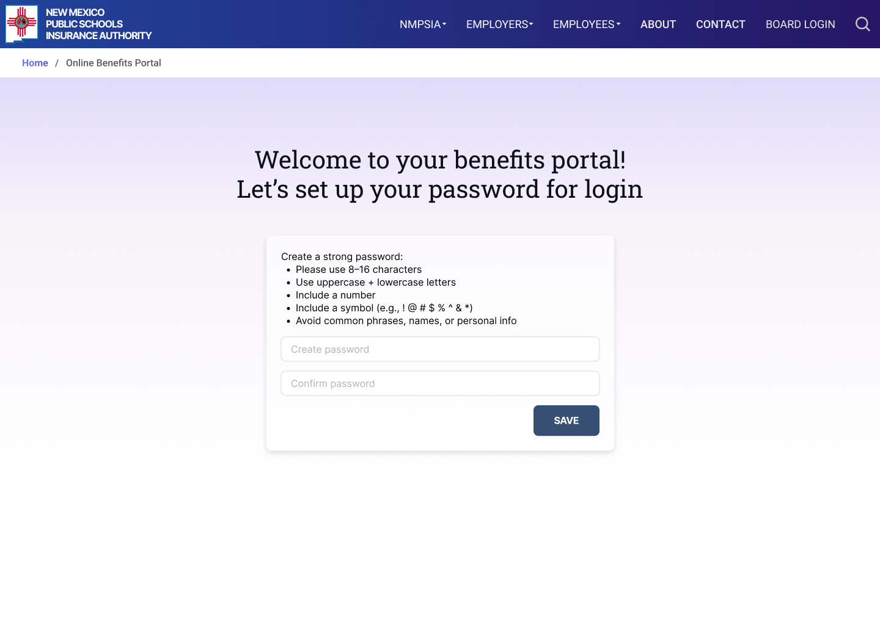
Step 4 NEW USER
Slide 5 of 21
NEW USER
You can now create a password which will be required to access your account moving forward.
Create a password that meets the listed criteria.
Confirm the password.
Click SAVE.
1
2
3

Slide 6
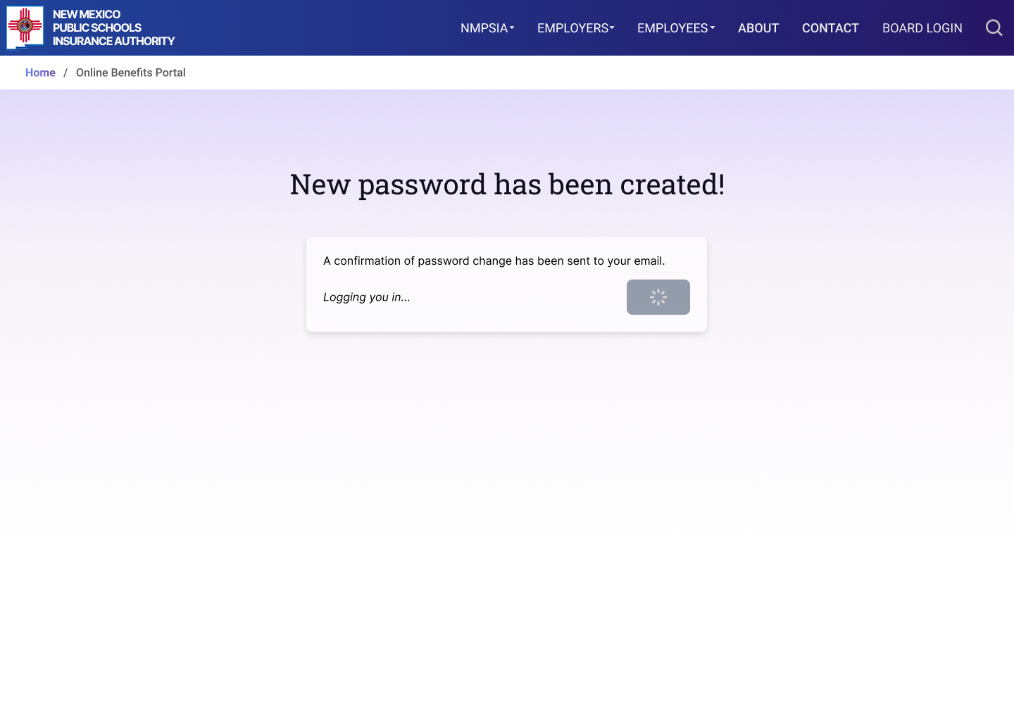
Step 5 NEW USER
Slide 6 of 21
NEW USER
You will see a message showing that your password has been created.
You will automatically be logged in and will be allowed to access to the MyBenefits Portal.

Slide 7
Step 1 EXISTING USER
Slide 7 of 21
NEW USER
Go to NMPSIA.com
↓
Benefits Portal Login
↓
Select Employee
↓
Continue to Step 2

Slide 8
Step 2 EXISTING USER
Slide 8 of 21
EXISTING USER
1. Enter the email you provided when you enrolled in NMPSIA benefits.
2. Certify you are not a robot.
3. Click GET STARTED.
1
2
3

Slide 9
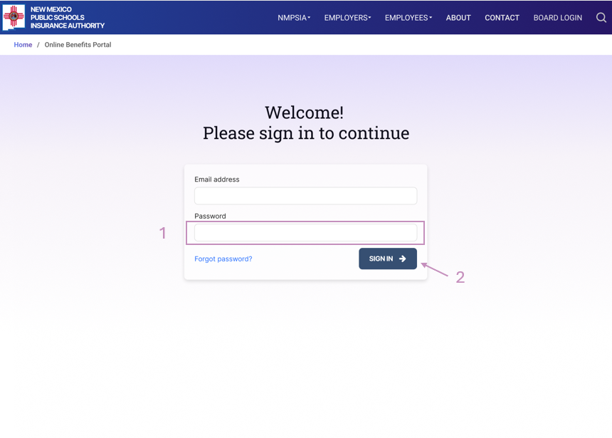
Step 3 EXISTING USER
Slide 9 of 21
EXISTING USER
Your email address will auto-populate in the designated field.
Enter your password
Click SIGN IN
If you forgot your password, click “Forgot password” to create a new one.

Slide 10
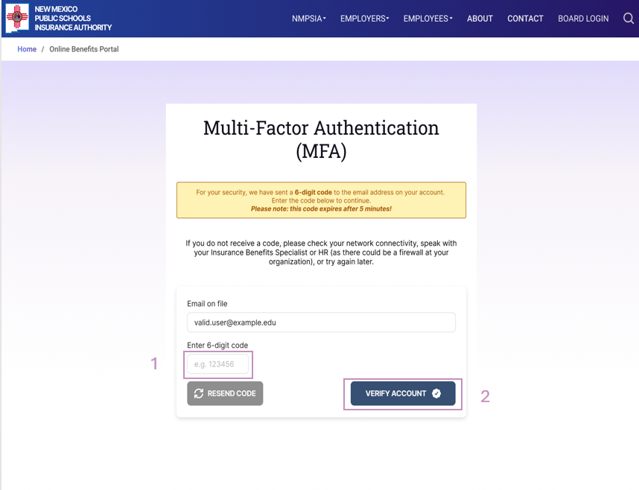
Step 4 EXISTING USER
Slide 10 of 21
EXISTING USER
A Multi- Factor Authentication (MFA) code will be sent to your email.
1. Enter the code and
2. Click VERIFY ACCOUNT
Note: This code will expire after 5 minutes.

Slide 11
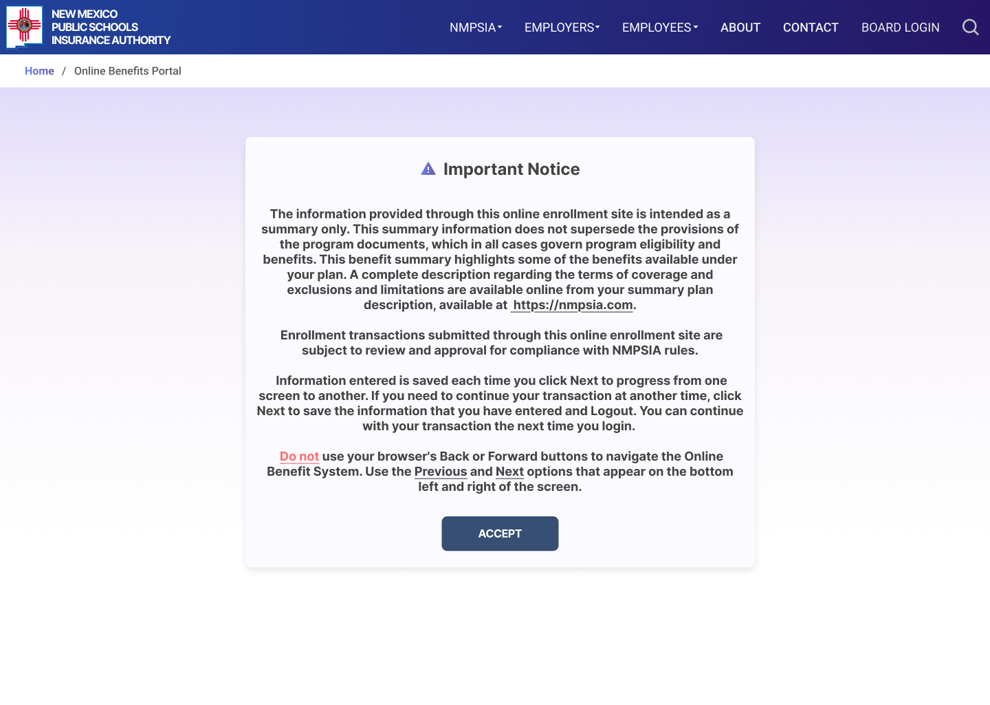
Step 5 EXISTING USER
Slide 11 of 21
EXISTING USER
Read the details under “Important Notice”, then click ACCEPT to continue.

Slide 12
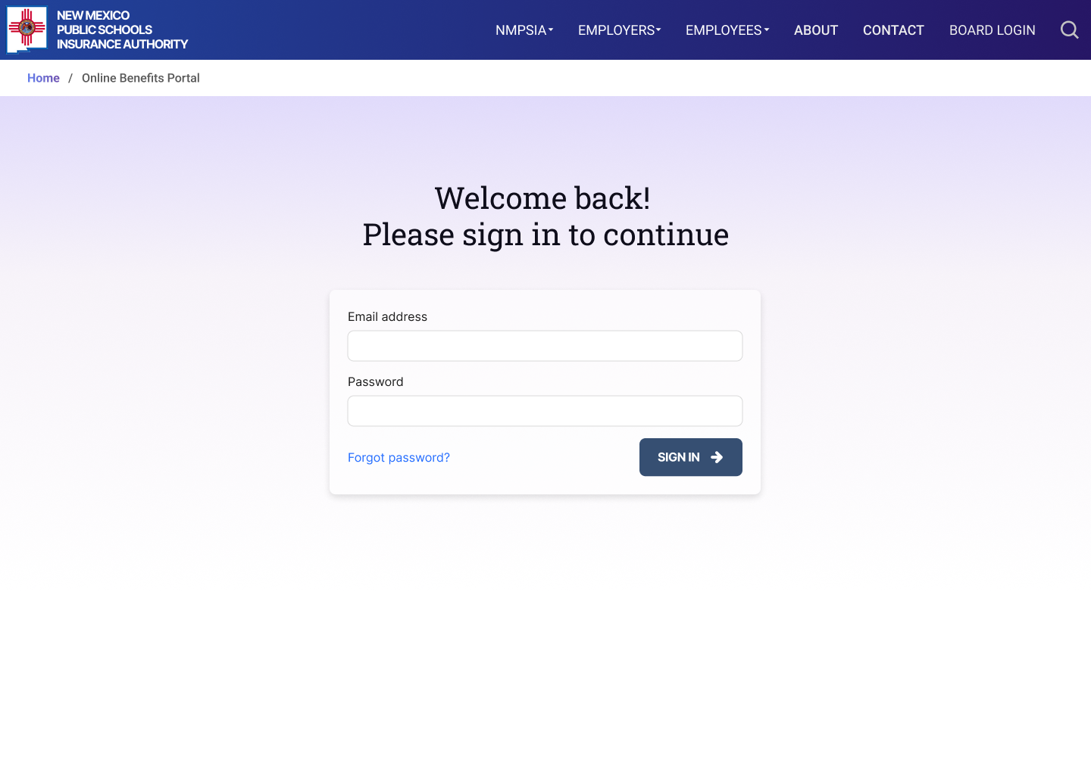
Step 1 FORGOT PASSWORD
Slide 12 of 21
FORGOT PASSWORD
If you forget your password,
use the “Forgot Password” feature.

Slide 13
Step 2 FORGOT PASSWORD
Slide 13 of 21
FORGOT PASSWORD
A Multi- Factor Authentication (MFA) code will be sent to your email.
1. Enter the code and
2. Click VERIFY ACCOUNT
Note: This code will expire after 5 minutes.
1
2

Slide 14
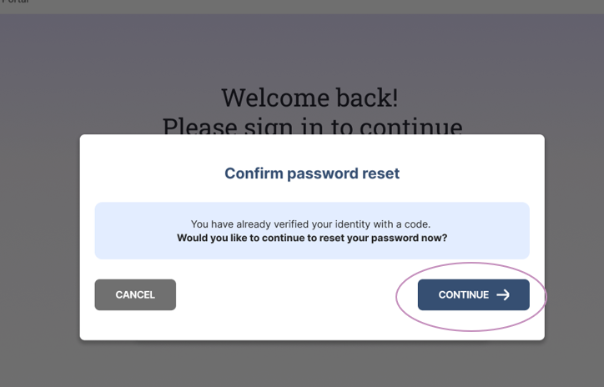
Step 3 FORGOT PASSWORD
Slide 14 of 21
FORGOT PASSWORD
You will be asked to confirm you would like to reset your password. Click CONTINUE to proceed.

Slide 15
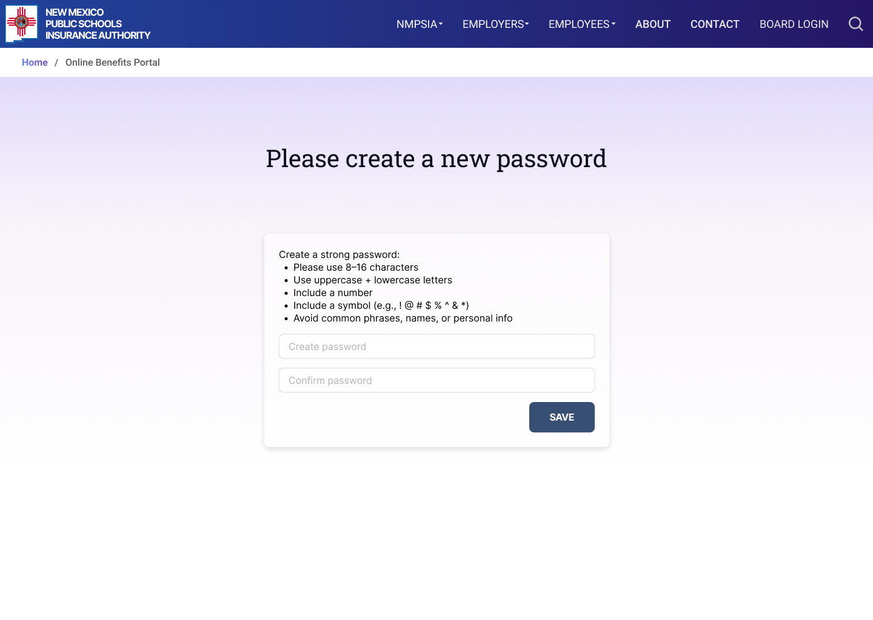
Step 4 FORGOT PASSWORD
Slide 15 of 21
FORGOT PASSWORD
You can now create a password which will be required to access your account moving forward.
Create a password that meets the listed criteria.
Confirm the password.
Click SAVE.
1
2
3

Slide 16
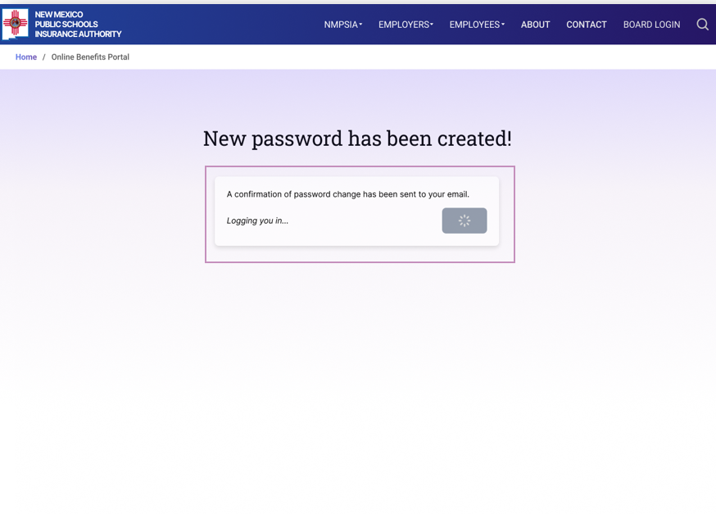
Step 5 FORGOT PASSWORD
Slide 16 of 21
FORGOT PASSWORD
You will see a message showing that your password has been changed.
You will automatically be logged in and will be allowed to access to the MyBenefits Portal.

Slide 17
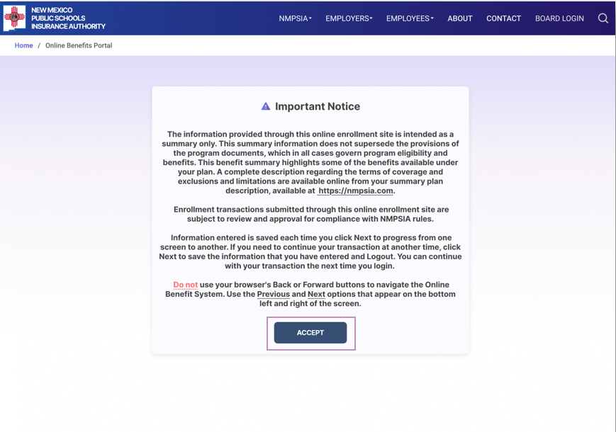
Step 6 FORGOT PASSWORD
Slide 17 of 21
FORGOT PASSWORD
Read the details under “Important Notice”, then click ACCEPT to continue.

Slide 18
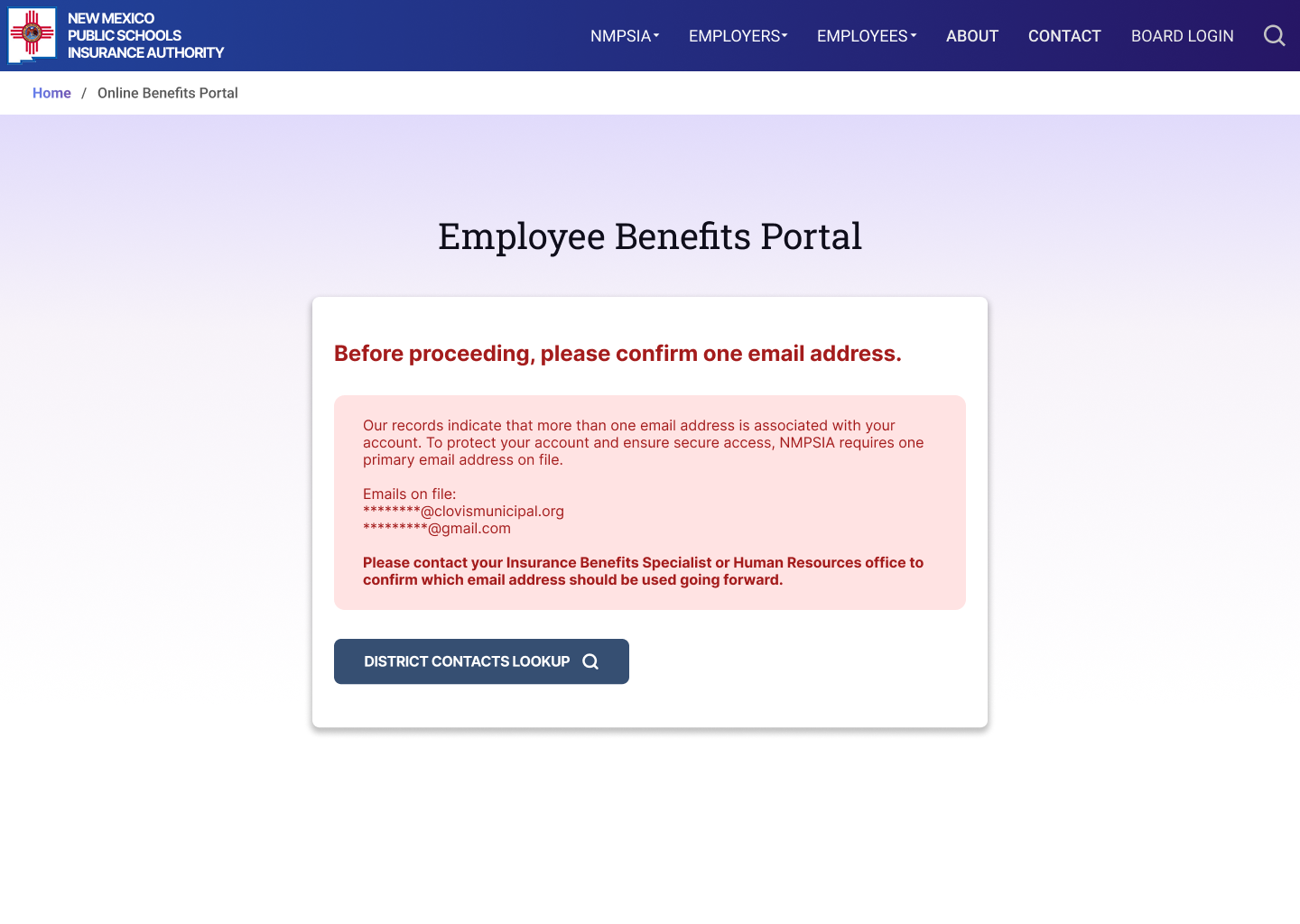
MERGE EMAILS
Slide 18 of 21
MERGE EMAIL- Notice
If you receive this notice after entering your email on the initial login screen, you must contact your Benefits Specialist or Human Resources Department to correct your email address before you can view your benefits information.

Slide 19
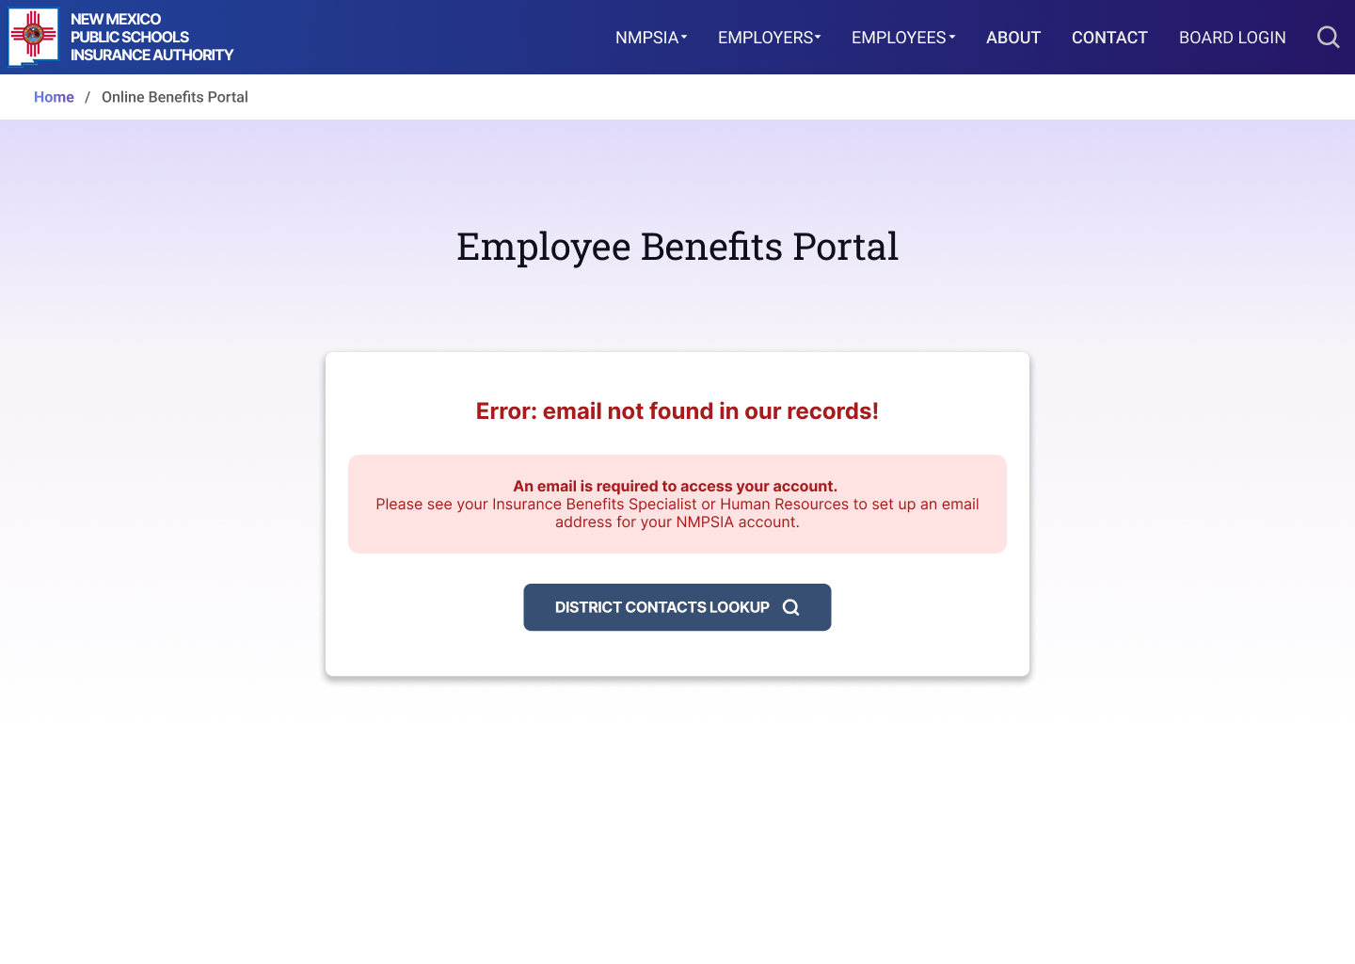
EMAIL NOT FOUND
Slide 19 of 21
EMAIL NOT FOUND Notice
If you receive this notice after entering an email, you do not have an email on file. Contact your Benefits Specialist or Human Resources Department for assistance. A valid email address is required before you can proceed.

Slide 20
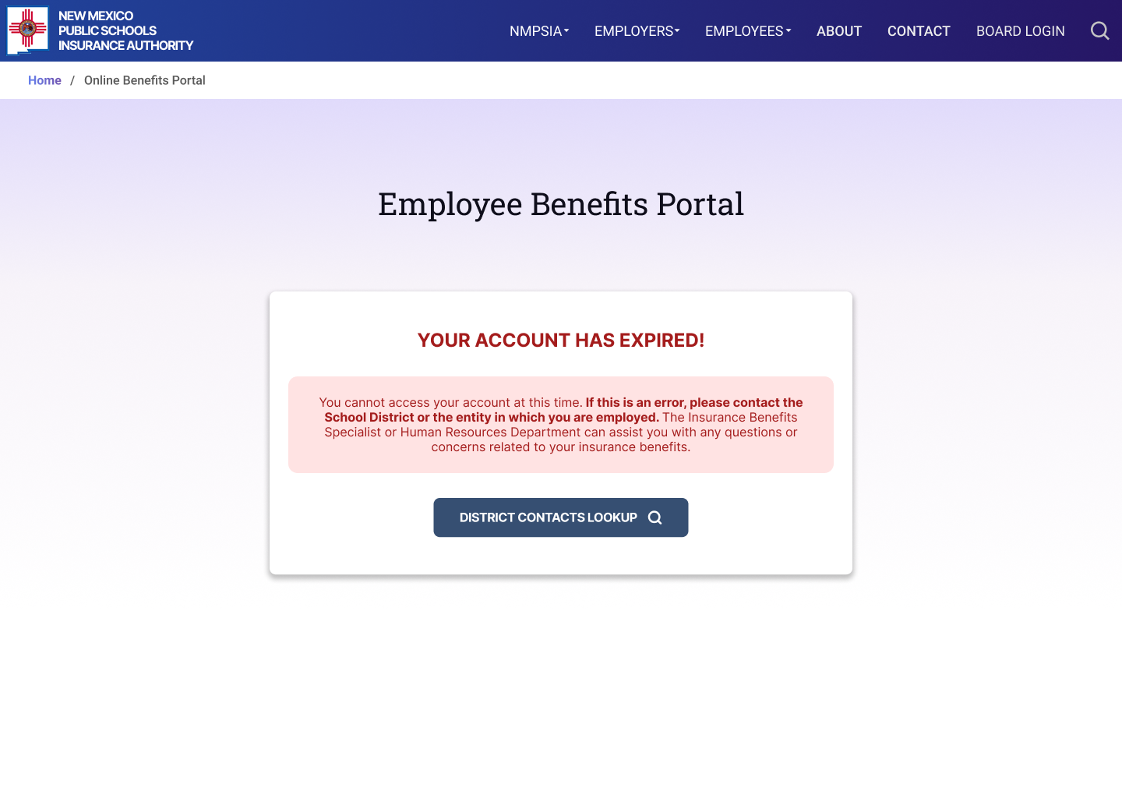
EXPIRED ACCOUNT
Slide 20 of 21
EXPIRED ACCOUNT
If you receive this notice after entering an email, your account is not longer active.
If you believe this is an error, please contact the School District or the entity with whom you are employed. The Benefits Specialist or Human Resources Department can assist you with any questions or concerns related to your insurance benefits.

Slide 21
NEED ASSISTANCE?
Slide 21 of 21
Thank you for using the NMPSIA MyBenefits Portal!
Contact Us:
EASI Edu
Phone: 1-800-233-3164
Contact your assigned representative for portal assistance.
Or
NMPSIA Benefits Team
Phone: 1-800-548-3724

